Slide 1
Cypress Tutorial
By: Mohammad Monfared

Slide 2
What is Cypress?
Cypress is a testing framework based on JavaScript that can test anything runs on a web browser. We can use JavaScript or TypeScript in Cypress.

Slide 3
Why Cypress?
Open Source and Free with big community
Faster than Selenium – Interact with browser session directly
Can be used by QAs and Developers (Unit/Integration/E2E tests)
Time Travel – Getting Snap shot of all actions
Debuggability
Automatic wait for assertions
Intercept / Spy
Real time reloads
Cypress dashboard
Screenshots and Video Records
Robust documentation

Slide 4
Limits
Doesn't support XPath
Doesn't support Safari / (Supported Browsers: Chrome, Firefox, Edge, Electron )
IDE Debug is not supported. Pause and debug on checkpoints is not possible
Doesn't keep user Auth state and Login Info by default
Async/Await approach
Problem with CI/CD integration on third-party hosted agents.
You have to add a lot of dependencies and plugins to support all your test scenarios.

Slide 5

Commands
Project Initialize
Install Cypress in project
Check version of installed Cypress
Open Cypress GUI (and Initialize on first time)
Run Cypress test in Command Line (headless by default)
Run Cypress test in Command Line with showing browser

Slide 6
Cypress Tutorial S02: Locate Elements

Slide 7
S02 – Basic Syntax
cy.get(CSS SELECTOR) // Element
cy.contains(Text)
cy.contains(selector, Text)
cy.get(selector).contains(Text)

Slide 8
Relatives:
1- children()
cy.get(selector).children()
cy.get(selector).children(selector)
2- parent()
cy.get(selector).parent()
cy.get(selector).parent(selector)

Slide 9
Relatives:
3- siblings()
cy.get(selector).siblings()
cy.get(selector).siblings(selector)

Slide 10
Ancestors:
1- parents()
cy.get(selector).parents()
cy.get(selector).parents(selector)
2- parentsUntil()
cy.get(selector).parentsUntil(selector)

Slide 11
Descendant:
1- find()
cy.get(selector).find(selector)
2- within()
cy.get(selector).within(() => { <code> } )

Slide 12
Index:
cy.get(selector).eq(index)
cy.get(selector).first()
cy.get(selector).last()

Slide 13
Filter:
cy.get(selector).filter(selector)
cy.get(selector).not(selector)

Slide 14
Traversal:
1- .closest(selector)
2- .next(selector)
3- .nextAll(selector)
4- .nextUntill(selector)
5- .prev(selector)
6- .prevAll(selector)
7- .prevUntill(selector)

Slide 15
Cypress Tutorial S03: Mouse & Keyboard Actions

Slide 16
Keyboard Actions:
Basic Syntax:
cy.get(selector).type(“TEXT”)

Slide 17
Keyboard Actions:
Sequences:
cy.get(selector).type(“TEXT{enter}”)
cy.get(selector).type(“{shift}TEXT”)
cy.get(selector).type(“{backspace}{home}{del}”)
cy.get(selector).realPress(“[‘Control’, ‘A’, ‘Del’]”)

Slide 18
Keyboard Actions:
Clear Input:
cy.get(selector).clear()
cy.get(selector).type(“{selectall}{del}”)
cy.get(selector).type(“{selectall}{backspace}”)
cy.get(selector).realPress(“[‘Control’, ‘A’, ‘Del’]”)

Slide 19
Keyboard Actions:
Delay:
cy.get(selector).type(“TEXT”, {delay: 100})
Repeat:
cy.get(selector).type(“TEXT”, {repeat(4)})

Slide 20
Mouse Actions:
1- Click
2- Double Click
3- Right Click
4- Hover
5- Long Press (Click and Hold)
6- Drag & Drop
7- Drag & Drop by offset
8- Scroll

Slide 21
Cypress Tutorial S04: Asynchronous | .then()

Slide 22
What is Promise?

Slide 23


Sync and Async
Sync
Async

Slide 24

Sync and Async

Slide 25
.then()
Syntax:
cy.get(selector).then( (VAR) => { code block } )
cy.get(selector).then( (VAR) => function() )

Slide 26
Usages of .then():
1- Handle JS Promises
2- Extract Values
3- Assertions
4- Debugging
5- Aliases ( .as() )

Slide 27
Cypress Tutorial S05: Interact with Elements 1
Checkbox / Radio Button / Switch / Dropdown / Chips

Slide 28
Checkbox / Radio Button / Switch
cy.get(selector).check()
cy.get(selector).check( [‘val1’, ‘val2’] )

Slide 29
Checkbox / Radio Button / Switch
cy.get(selector).should(‘be.checked’)
cy.get(selector).should(‘not.be.checked’)
cy.get(selector).should(‘be.enabled’)
cy.get(selector).should(‘not.be.enabled’)

Slide 30
Drop Down / Chips
1- Native HTML select Tag:
cy.get(selector).select(‘option value’)
cy.get(selector).select(‘Text’)
cy.get(selector).select(index)
2- Other types / Chips:
cy.get(#dropdown).click() cy.get(#option).click()

Slide 31
Cypress Tutorial S06: Interact with Elements 2
Alert / Dialog (Popup) / Snackbar (Toast Message)/ Tooltip

Slide 32
Interact With Elements 2:
1- Alert - Alert
2- Alert – Confirm (Accept)
3- Alert – Confirm (Dismiss)
4- Alert – Prompt
5- Dialog (Popup)
6- Snackbar
7- Tooltip

Slide 33
Cypress Tutorial S07: Interact with Elements 3
Multiple Elements (Array)/ Web table / each() / wrap()

Slide 34
Cypress Tutorial S08: Hooks
describe() / context() / it() / specify()
before() / after() / beforeEach() / afterEach()
skip / only

Slide 35
Cypress Tutorial S09: Cypress Version 10
New features / Changes / Migrate

Slide 36

New Feature: Component Testing

Slide 37

New Cypress App

Slide 38


New Test Runner (Overview)
v9.x
v10

Slide 39


New Test Runner (Logger)
v9.x
v10

Slide 40
Files/Folders structure

Slide 41
Cypress Tutorial S10: Aliases ( .as() )

Slide 42
Usages
1- Reuse DOM elements
2- Sharing Variables / Fixtures
3- Intercept()
4- Request()

Slide 43
Cypress Tutorial S11: Functions | Custom Commands

Slide 44
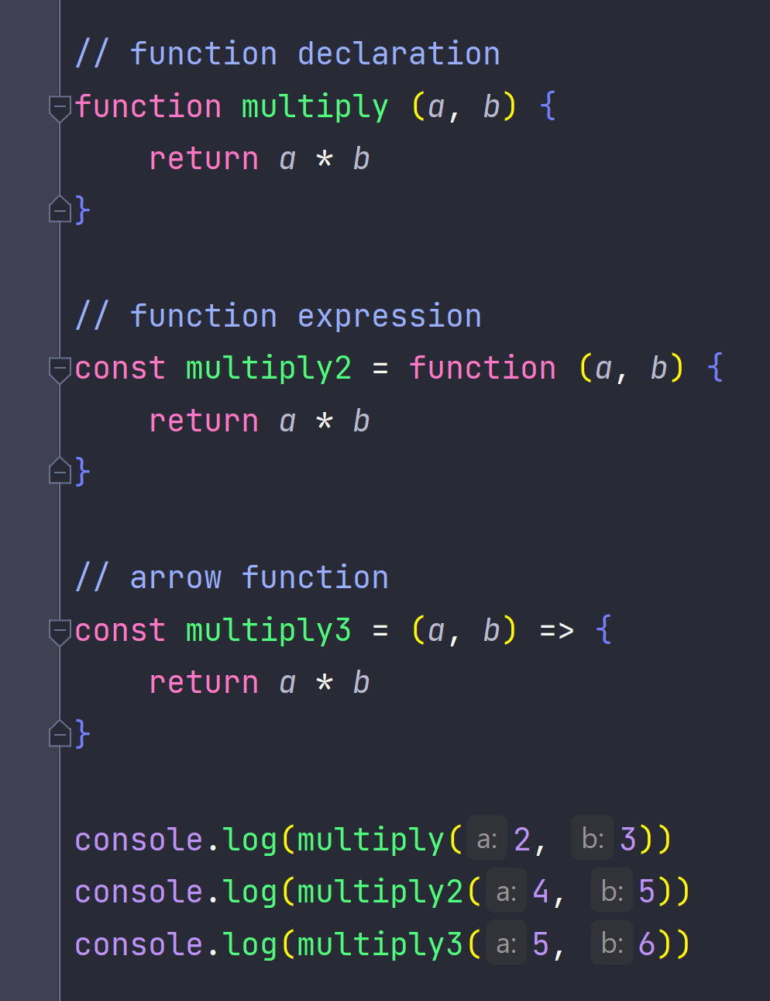
Define Functions + Scope

Slide 45
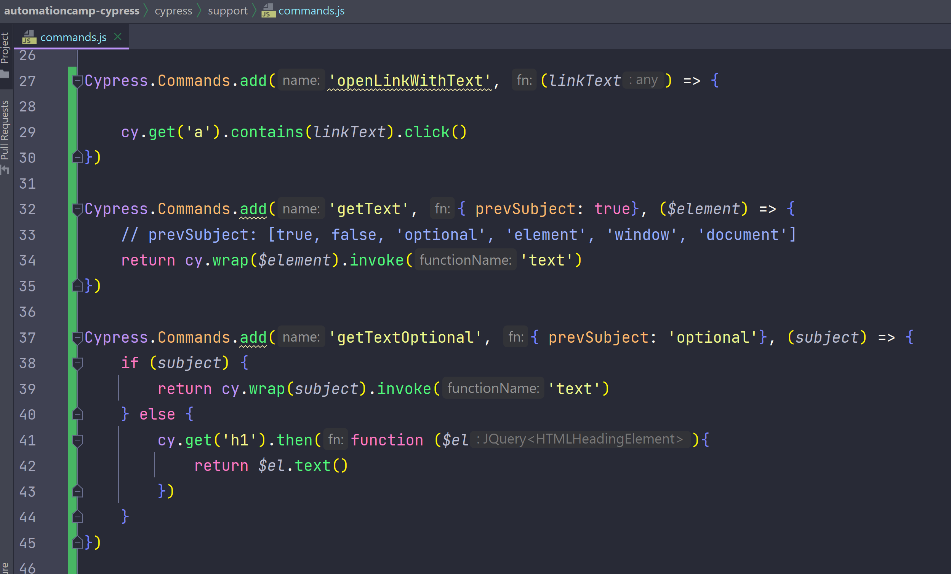
Custom Commands

Slide 46
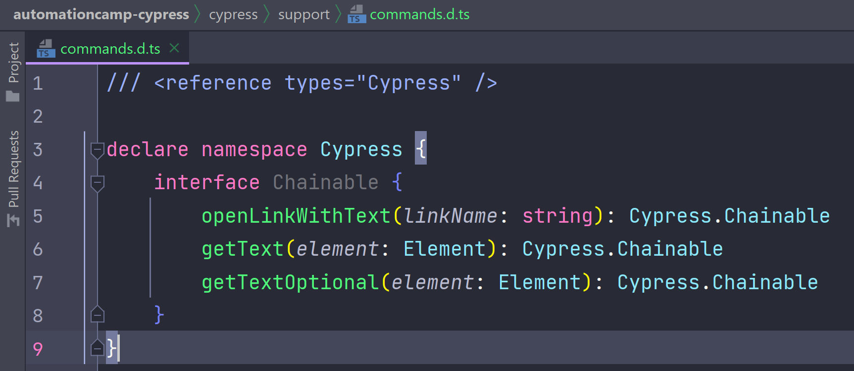
Type Declaration

Slide 47
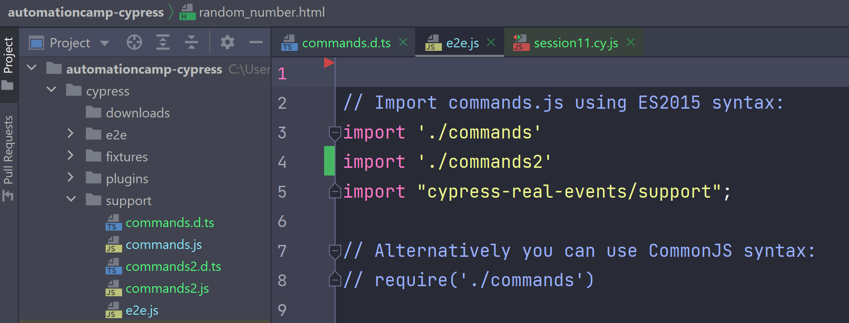
Multiple Commands Files

Slide 48
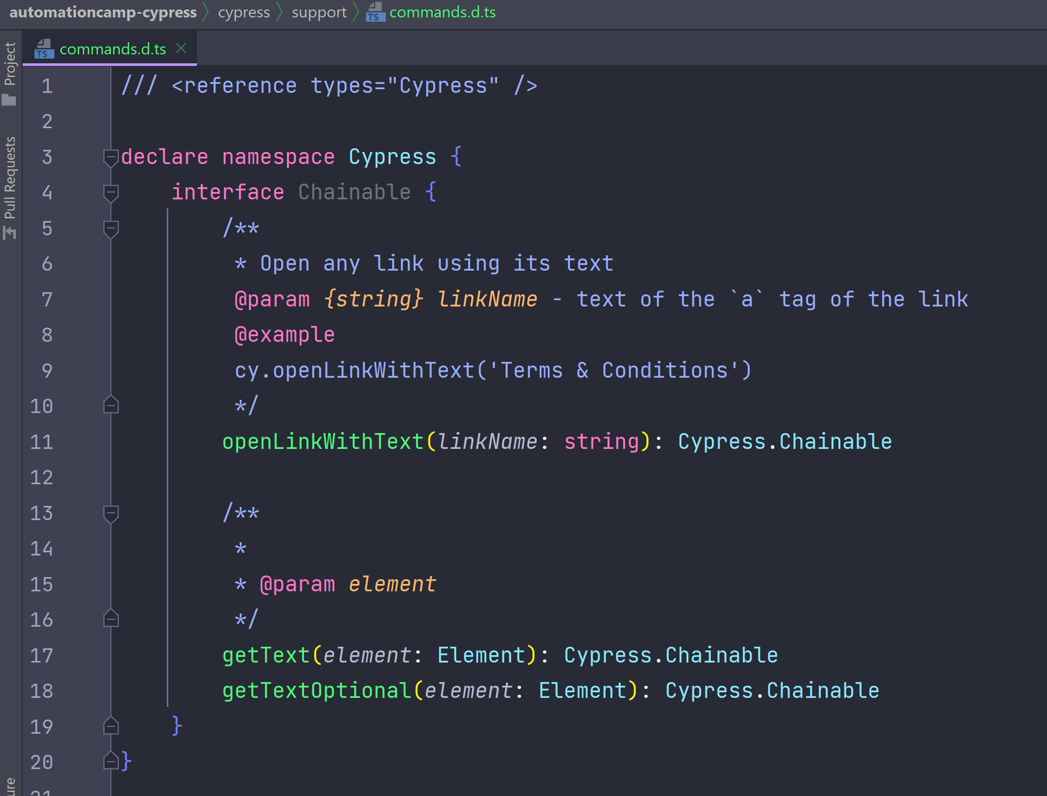
Documentation

